Slide 1
2022 Sports
Parent Meeting

Slide 2
Jason Menard - Athletic Director
jmenard@usd396.net

Slide 3
“Like” the Douglass High School Facebook Page
Follow Douglass High School on Twitter
Follow douglass_bulldogs on Instagram

Slide 4
PHYSICALS

Slide 5
CentralPlainsLeague.com

Slide 6
Student Insurance - Secondary insurance
By playing a sport, you are taking on the assumption of risk that comes with it. Douglass High School and Sisk Middle school are proactive in the equipment we purchase and provide to keep the environment as safe as we can at all times.
Student gets injured
See the doctor
Receive the medical bills from doctors visits
Fill out Insurance form located in DHS/Sisk office
Mail the form with medical bills to the Student Assurances offices
Other than providing the form, everything else is between the insurance company and family, the school is not involved

Slide 7
Communication
Student to Parent
Student to Coach
Student and Parent to Coach
Student and Parent to Coach and Admin
THIS SHOULD NEVER TAKE PLACE LESS THAN 24 HOURS AFTER INCIDENT OR GAME

Slide 8
PERSPECTIVE

Slide 9
Eligibility
A weekly eligibility report will be ran every monday
Students that are failing 2 or more classes will become ineligible for that week
If a student raises a grade, they will become immediately eligible again.
This puts the learning and accountability back on the student athlete
STUDENT > ATHLETE

Slide 10
Middle School Bulldog Club!
Nicole Stahl - President

Slide 11
DHS Booster Club!
Deanna Estes - President
August 28 @ 2:00PM South Commons

Slide 12
MAO Trainer
Contract with MidAmerica Orthopedic
3pm arrival on practice days
1-2 hours before games
Usually contact 3x a week MINIMUM with DHS/DMS

Slide 13
Officials/Sportsmanship

Slide 14
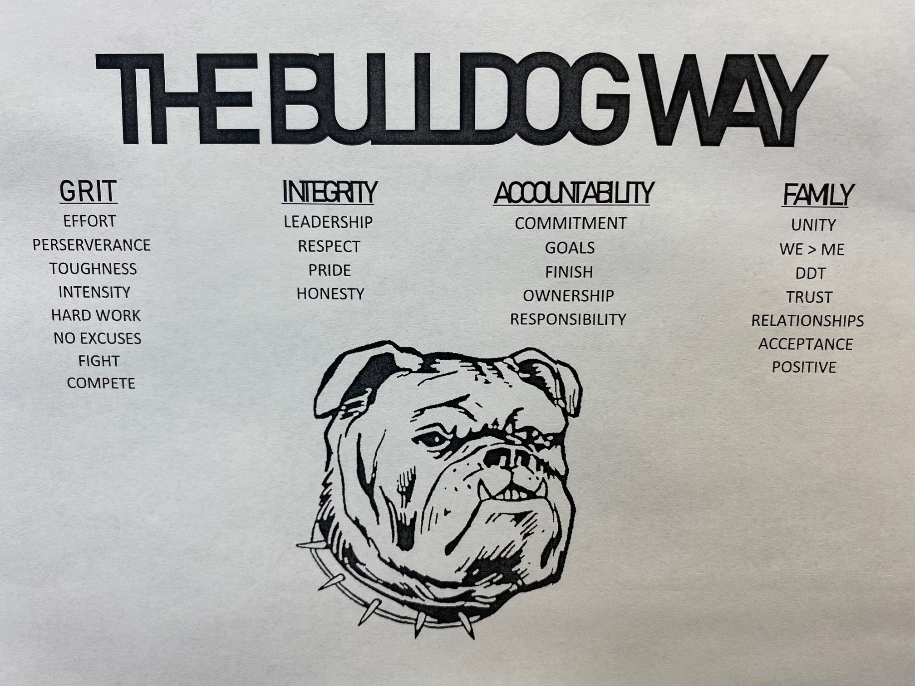

Slide 15
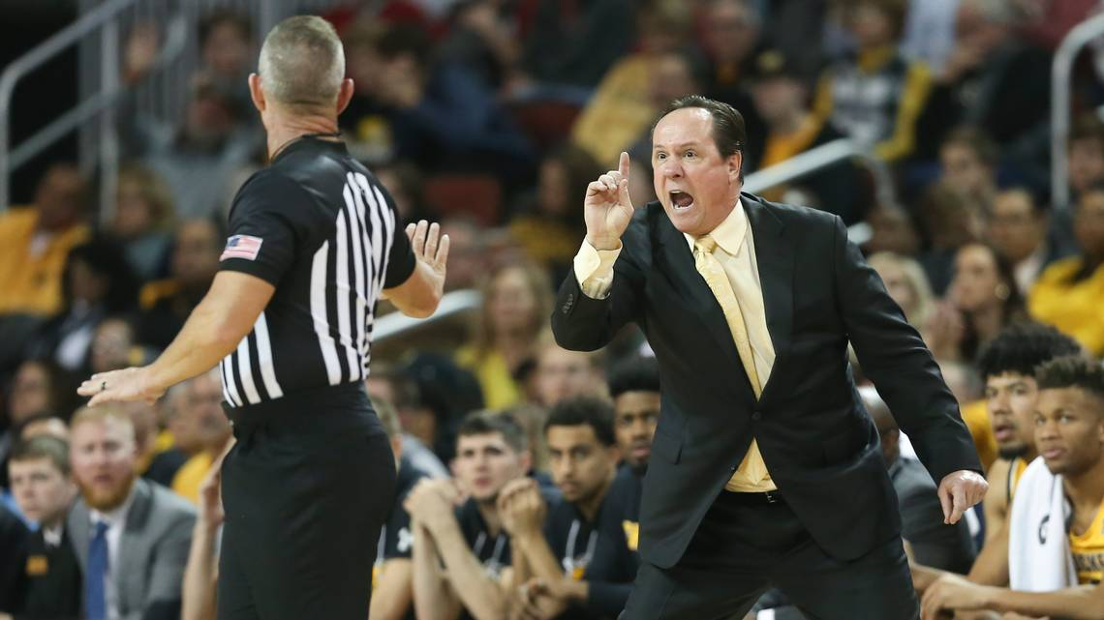

Slide 16
Purple and Gold Scrimmage Night
Friday, August 26th
5:00pm - HS/MS/Rec Volleyball - HS GYM
5:45pm - Jr. Football Scrimmages
6:15pm - XC Showcase
6:30pm - Middle School Football
7:00pm - High School Football Jamboree (Trinity and Medicine Lodge)
HOT DOGS, CHIPS, COOKIES AND DRINKS SERVED AT 5:30PM

Slide 17
CPL League Pass raffle time

Slide 18
Fall Sport Team Meetings
HS Football - Stay in Auditorium
MS Football - Lounge Area
MS/HS Cross Country - Coach Wasson’s Room
HS Volleyball - HS Commons Area
MS Volleyball - South MPR
HS Cheerleading - Coach Christner’s Room

